Slide 1
Assembly Language for Intel-Based Computers, 4th Edition
Kip R. Irvine
Chapter 7: Integer Arithmetic
Slides prepared by Kip R. Irvine
Revision date: 07/11/2002
Chapter corrections (Web) Assembly language sources (Web)
(c) Pearson Education, 2002. All rights reserved. You may modify and copy this slide show for your personal use, or for use in the classroom, as long as this copyright statement, the author's name, and the title are not changed.

Slide 2
Lecture Overview
Shift and Rotate Instructions
Shift and Rotate Applications
Irvine, Kip R. Assembly Language for Intel-Based Computers, 2003.

Slide 3
Shift and Rotate Instructions
Logical vs Arithmetic Shifts
SHL Instruction
SHR Instruction
SAL and SAR Instructions
ROL Instruction
ROR Instruction
RCL and RCR Instructions
Irvine, Kip R. Assembly Language for Intel-Based Computers, 2003.

Slide 4


Logical vs Arithmetic Shifts
A logical shift fills the newly created bit position with zero:
An arithmetic shift fills the newly created bit position with a copy of the number’s sign bit:
Irvine, Kip R. Assembly Language for Intel-Based Computers, 2003.

Slide 5

SHL Instruction
The SHL (shift left) instruction performs a logical left shift on the destination operand, filling the lowest bit with 0.
Irvine, Kip R. Assembly Language for Intel-Based Computers, 2003.

Slide 6

Fast Multiplication
Shifting left 1 bit multiplies a number by 2
mov dl,5
shl dl,1
Shifting left n bits multiplies the operand by 2^{n}
For example, 5 * 2² = 20
mov dl,5
shl dl,2 ; DL = 20
Irvine, Kip R. Assembly Language for Intel-Based Computers, 2003.

Slide 7
SHR Instruction
The SHR (shift right) instruction performs a logical right shift on the destination operand. The highest bit position is filled with a zero.
Shifting right n bits divides the operand by 2^{n}
mov dl,80
shr dl,1 ; DL = 40
shr dl,2 ; DL = 10
Irvine, Kip R. Assembly Language for Intel-Based Computers, 2003.

Slide 8
SAL and SAR Instructions
SAL (shift arithmetic left) is identical to SHL.
SAR (shift arithmetic right) performs a right arithmetic shift on the destination operand.
An arithmetic shift preserves the number's sign.
mov dl,-80
sar dl,1 ; DL = -40
sar dl,2 ; DL = -10
Irvine, Kip R. Assembly Language for Intel-Based Computers, 2003.

Slide 9
Your turn . . .
Indicate the hexadecimal value of AL after each shift:
mov al,6Bh
shr al,1 a.
shl al,3 b.
mov al,8Ch
sar al,1 c.
sar al,3 d.
35h
A8h
C6h
F8h
Irvine, Kip R. Assembly Language for Intel-Based Computers, 2003.

Slide 10

ROL Instruction
ROL (rotate) shifts each bit to the left
The highest bit is copied into both the Carry flag and into the lowest bit
No bits are lost
mov al,11110000b
rol al,1 ; AL = 11100001b
mov dl,3Fh
rol dl,4 ; DL = F3h
Irvine, Kip R. Assembly Language for Intel-Based Computers, 2003.

Slide 11

ROR Instruction
ROR (rotate right) shifts each bit to the right
The lowest bit is copied into both the Carry flag and into the highest bit
No bits are lost
mov al,11110000b
ror al,1 ; AL = 01111000b
mov dl,3Fh
ror dl,4 ; DL = F3h
Irvine, Kip R. Assembly Language for Intel-Based Computers, 2003.

Slide 12
Your turn . . .
Indicate the hexadecimal value of AL after each rotation:
mov al,6Bh
ror al,1 a.
rol al,3 b.
B5h
ADh
Irvine, Kip R. Assembly Language for Intel-Based Computers, 2003.

Slide 13
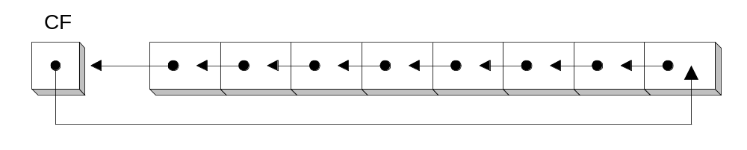
RCL Instruction
RCL (rotate carry left) shifts each bit to the left
Copies the Carry flag to the least significant bit
Copies the most significant bit to the Carry flag
mov bl, 0
add bl, 1 ; CF = 0
mov bl,88h ; CF,BL = 0,10001000b
rcl bl,1 ; CF,BL = 1,00010000b
rcl bl,1 ; CF,BL = 0,00100001b
Irvine, Kip R. Assembly Language for Intel-Based Computers, 2003.

Slide 14
RCR Instruction
RCR (rotate carry right) shifts each bit to the right
Copies the Carry flag to the most significant bit
Copies the least significant bit to the Carry flag
mov bl, FFh
add bl, 1 ; CF = 1
mov ah,10h ; CF,AH = 00010000,1
rcr ah,1 ; CF,AH = 10001000,0
Irvine, Kip R. Assembly Language for Intel-Based Computers, 2003.

Slide 15
Your turn . . .
Indicate the hexadecimal value of AL after each rotation:
mov bl, FFh
add bl, 1
mov al,6Bh
rcr al,1 a.
rcl al,3 b.
B5h
AEh
Irvine, Kip R. Assembly Language for Intel-Based Computers, 2003.

Slide 16

The End
Irvine, Kip R. Assembly Language for Intel-Based Computers, 2003.

